Slide 1
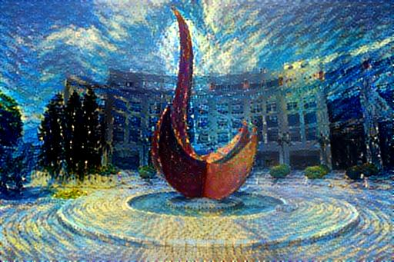
Mathematical Foundations of Computation, Deep Learning, and Quantum TDA
Yuan YAO
HKUST

Slide 2
Outline
Perceptrons and Finite Halting
Minsky-Papert (1969) Model:
locality/sparsity is a fundamental limit of neural networks
XOR and Topological computation
Deep Neural Networks
complexity and the curse-of-dimensionality (Poggio et al. 2017)
Geometric group invariants in deep networks (Mallat et al. 2012; Bolcskei et al. 2017)
Blum-Shub-Smale (1989) Model of Real Computation
Condition number is a fundamental limit of topology learning with finite samples
Topological Data Analysis
Computing robust topological invariants to scales and the curse-of-dimensionality
Quantum algorithms for topological data analysis
Polynomial complexity (Lloyd et al. 2016)
Demonstration of 3-point data by 6-photon quantum computer (Huang et al. 2018)
Chi-Chih Yao (2020)
Topology of datasets may decide the complexity of learning map, how?

Slide 3
Perceptron: single-layer

Slide 4
The Perceptron Algorithm
The Perceptron Algorithm is a Stochastic Gradient Descent method:

Slide 5
Finiteness of Stopping Time
Input ball:
Margin:

Slide 6
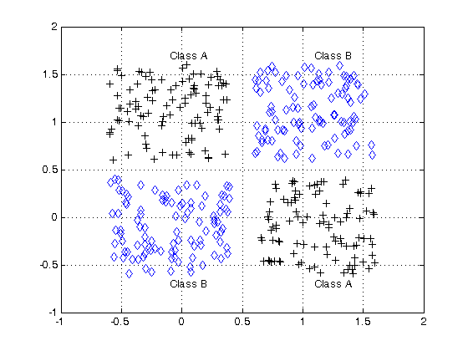
Locality or Sparsity of Computation
Minsky and Papert, 1969
Perceptron can’t do XOR classification
Perceptron needs infinite global information to compute connectivity
Locality or Sparsity is important:
Locality in time?
Locality in space?

Slide 7
Locality or Sparsity is a fundamental limitation
Minsky-Papert model admits infinitely many neurons (wide network) in parallel processing, yet only sparse or local inputs. Note that it is not a Turing model.

Slide 8
Examples of Finite Orders

Slide 9
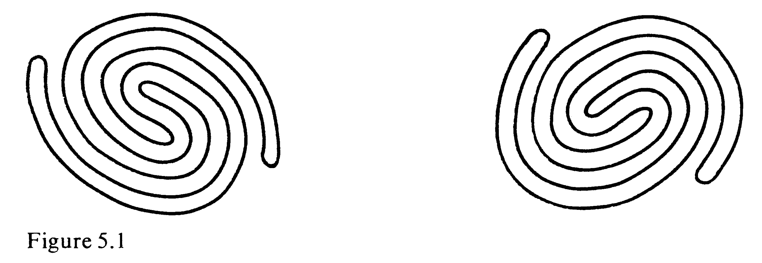
Connectivity is of infinite order
Which one of these two figures is connected?

Slide 10
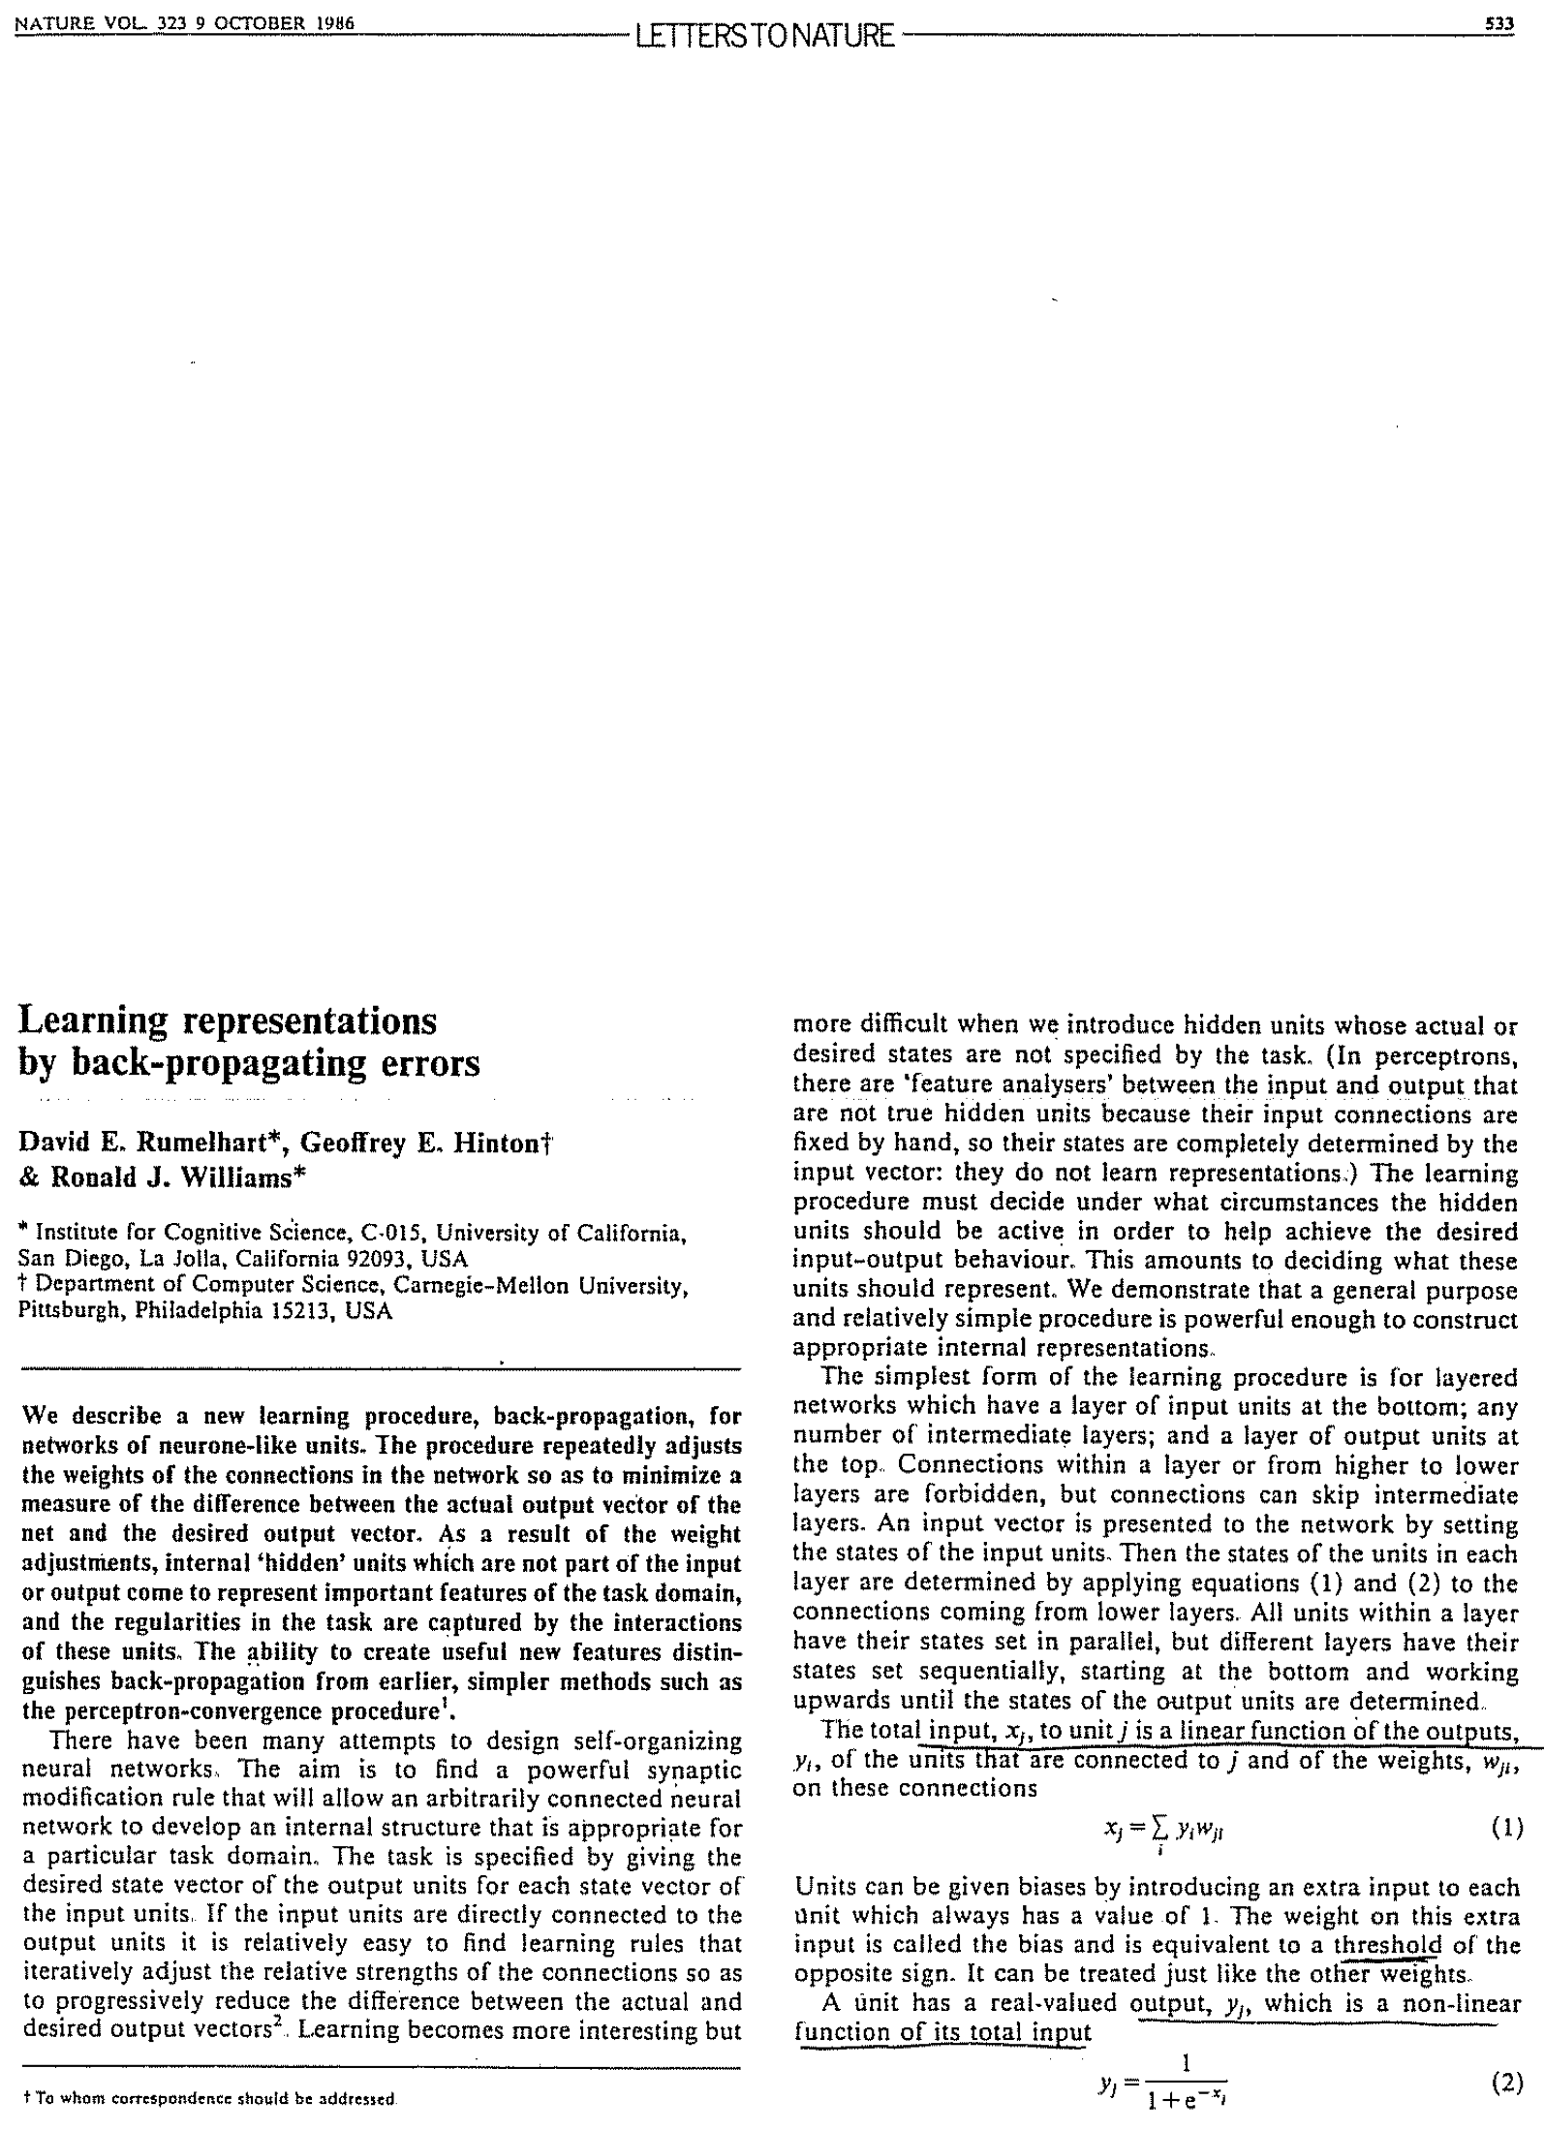
Multilayer Perceptrons (MLP) and Back-Propagation (BP) Algorithms
D.E. Rumelhart, G. Hinton, R.J. Williams (1986)
Learning representations by back-propagating errors, Nature, 323(9): 533-536
BP algorithms as stochastic gradient descent algorithms (Robbins–Monro 1950; Kiefer-Wolfowitz 1951) with Chain rules of Gradient maps
Deep network may classify XOR. Yet topology?
We address complexity and geometric invariant properties first.

Slide 11
Complexity of Deep Networks and the Curse of Dimensionality
Deep networks can avoid the curse of dimensionality with locality or sparsity.

Slide 12
Both deep and shallow models can approximate continuous functions, but suffering the curse of dimensionality…

Slide 13
Hilbert’s 13th Problem

Slide 14
Kolmogorov’s Superposition Theorem
If f is a multivariate continuous function, then f can be written as a finite composition of
continuous functions of a single variable and the binary operation of addition.

Slide 15
Curse of Dimensionality

Slide 16
A Blessing from Physical world? Multiscale “compositional” sparsity
(Or even of constant numbers.)

Slide 17
Convolutional Neural Networks (VGG, ResNet etc.) are of this type.

Slide 18
Geometric group invariant properties of deep networks
Contraction within-class level sets toward group invariants when depth grows, while keeping the separation between classes

Slide 19
High Dimensional Natural Image Classification

Slide 20
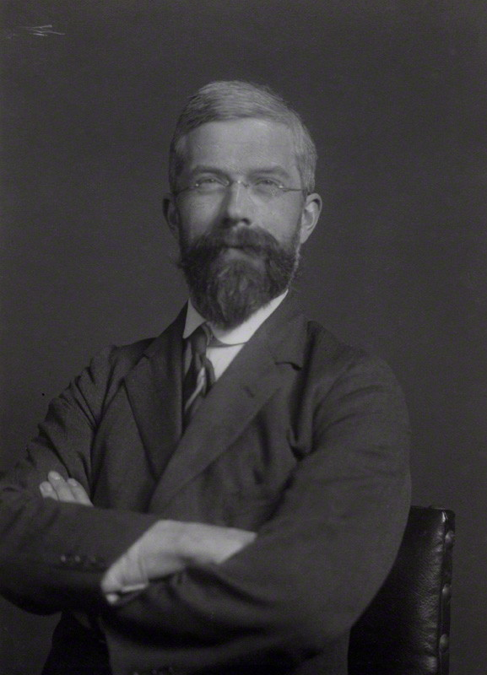
Fisher’s Linear Discriminant (1936) (Linear Dimensionality Reduction)

Slide 21
Nonlinear Level Set Group Symmetries
Level set symmetries lead to groups…

Slide 22
https://www.youtube.com/watch?v=nUDIoN-_Hxs

Slide 25
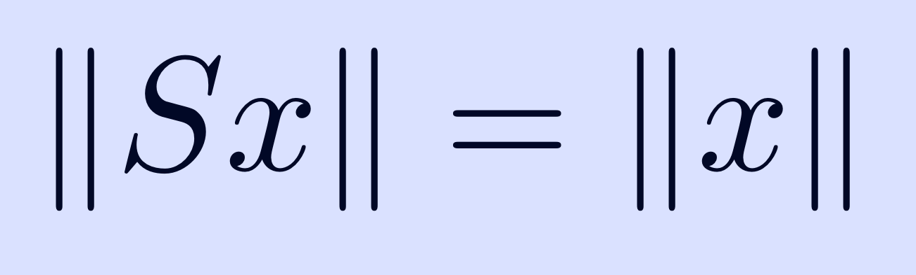
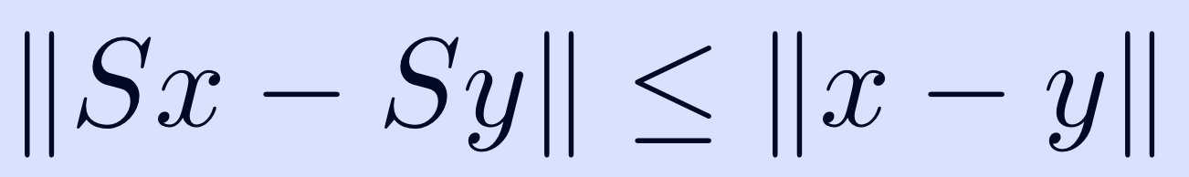
Wavelet Scattering Net Stephane Mallat et al. 2012
Architechture:
Convolutional filters: band-limited complex wavelets
Nonlinear activation: modulus (Lipschitz)
Pooling: averaging (L1)
Properties:
A Multiscale Sparse Representation
Norm Preservation (Parseval’s identity):
Contraction:

Slide 26
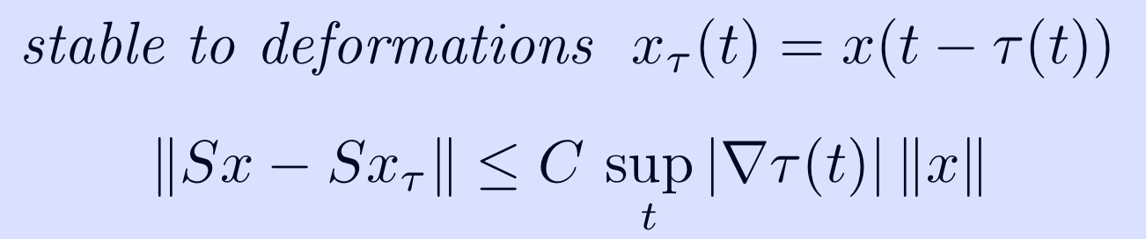
Invariants/Stability of Scattering Net
Translation Invariance (generalized to rotation and scaling):
Stable Small Deformations:

Slide 27
Wiatowski-Bolcskei’15
Scattering Net by Mallat et al. so far
Wavelet Linear filter
Nonlinear activation by modulus
Average pooling
Generalization by Wiatowski-Bolcskei’15
Filters as frames
Lipschitz continuous Nonlinearities
General Pooling: Max/Average/Nonlinear, etc.
As depth grows, the multiplicative pooling factors leads to full invariances.

Slide 28
Summary
All these works partially explains the success of CNNs
Contraction within level set symmetries toward invariance when depth grows
Separation kept between different levels (discriminant)
Other questions?
Can topology be learned with finite information?

Slide 29
Topology can be learned with finite information if the manifold is stable
Blum-Shub-Smale models of Real Computation

Slide 30
A Model of Real Computation
Starting from Blum, Shub, Smale (1989)
It admits inputs and operations (addition, substraction, multiplication, and (in the case of fields) division) of real (complex) numbers with infinite precision
“The key importance of the condition number, which measures the closeness of a problem instance to the manifold of ill-posed instances, is clearly developed.” – Richard Karp

Slide 31
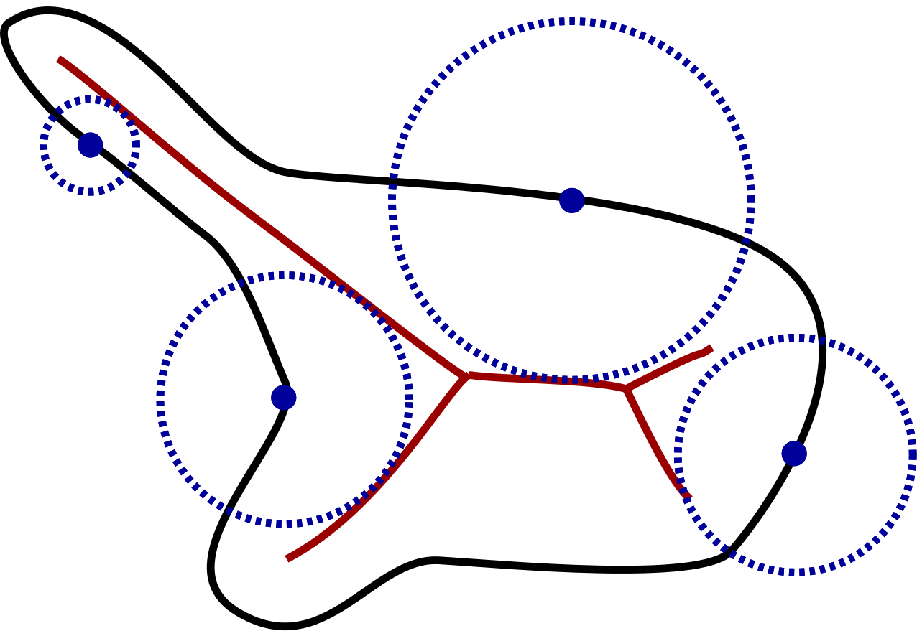
The Condition Number of a Manifold
Smallest Local Feature Size

Slide 32
Find Homology with Finite Samples [Niyogi, Smale, Weinberger (2008)]

Slide 33
Topological Data Analysis
How to compute topology from finite sample points with noise?

Slide 34
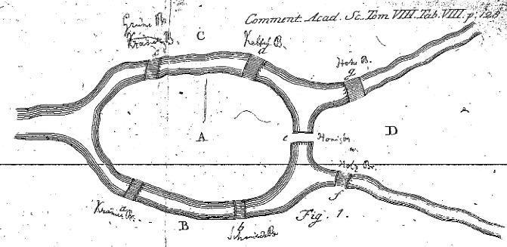
The origin of Topology

Slide 35
Discrete Data Analysis in Metric Space

Slide 38
Topological Data Analysis
Distance/metric measurements are noisy
Physical device like human eyes may ignore differences in proximity
Topology is the crudest way to capture invariants under distortions of distances
At the presence of noise, one need robust topology invariant with metric scales:
simplicial complexes for data representation
filtration on simplicial complexes
persistent homology

Slide 39
Simplicial Complexes

Slide 40
Boundary Map and Chain Complexes

Slide 41
Homology Groups and Betti Numbers

Slide 42
Hodge Theory for Real (co)-Homology

Slide 43
Abstract Simplicial Complex

Slide 44
Example I

Slide 45
Example II

Slide 47
Example III

Slide 49
E.g. Vietoris-Rips Complex of Tolerance Space

Slide 50
Persistent Homology

Slide 51
Betti Numbers and Scales

Slide 52
Betti Number and Scales

Slide 53
Persistent Homology Algorithm

Slide 54
Persistent Homology

Slide 55
Curse of Dimensionality and Quantum Algorithms
To construct a Rips-complex of dimension of n points: O(2^{n}) number of simplices is needed in the worst case => O(poly(n)) in Quantum Algorithms

Slide 56
Quantum Algorithms for Topological Data Analysis

Slide 58
Computational Complexity: Classical vs. Quantum

Slide 61
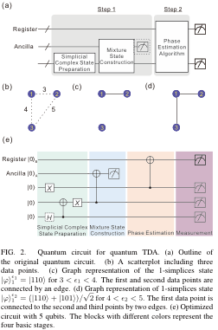
Demonstration by 6-photon Quantum Computer [Huang et al. 2018, arXiv:1801.06316]

Slide 62
Summary
Minsky-Papert (1969) Model:
locality/sparsity is a fundamental limit of neural networks
XOR is not possible for single layer perceptrons
Topological computation needs non-local (global) information
Deep Neural Networks
Both shallow and deep networks are universal, but suffer the curse-of-dimensionality
Locality/sparsity may avoid the curse-of-dimensionality (Poggio et al. 2017)
Geometric group invariants grow with depth (Mallat et al. 2012; Bolcskei et al. 2017)
Blum-Shub-Smale (1989) Model of Real Computation
Condition number of a manifold is a fundamental limit of topology learning with finite samples
Topological Data Analysis
Persistent homology suffers the curse-of-dimensionality
Quantum algorithms for topological data analysis
A polynomial complexity algorithm for homology computation (Lloyd et al. 2016)
A 3-point demonstration by 6-photon quantum computer (Huang et al. 2018)

Slide 63
Thank you!

